Slide 1
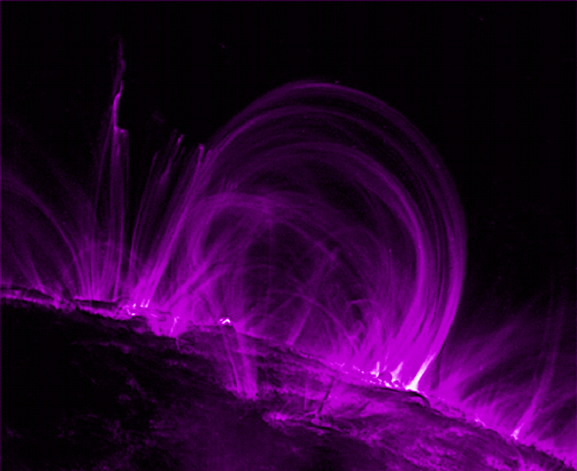
Magnetism and
Domain Theory

Slide 2
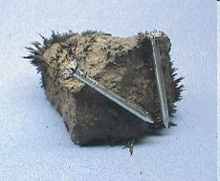
Some History…
Greeks discovered (600 B.C.) that certain type of iron ore (loadstone) was able to attract small pieces of iron

Slide 3

Magnetism
Greeks discovered a property of matter we now call “magnetism”
Today we make artificial magnets out of iron, nickel and cobalt
When a magnet is allowed to rotate freely, one of the poles tend to “seek” North (N-pole), the other “seeks” south
(S-pole)

Slide 4
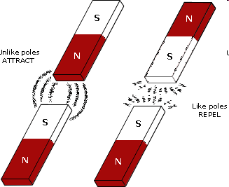
Law of Magnetism
Opposite magnetic poles attract
Similar magnetic poles repel
Bar Magnet

Slide 5

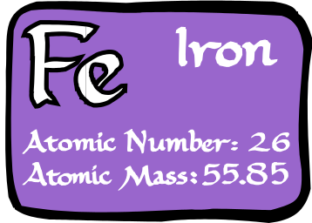
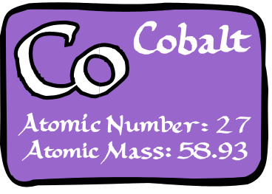
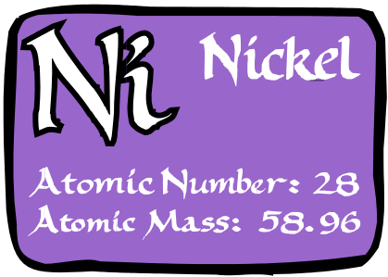
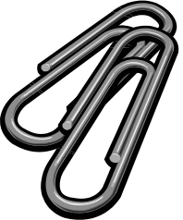

What is a Magnet?
A magnet is an object that produces an external magnetic field.
A magnet applies a force over a distance on magnetic materials and moving charged particles (e.g. electric currents).
Magnetic fields can also be caused by electrical currents.
What Materials are Magnetic?

Slide 6
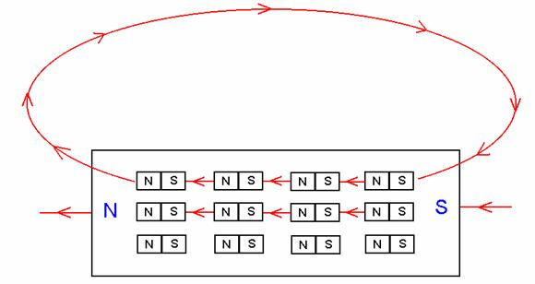
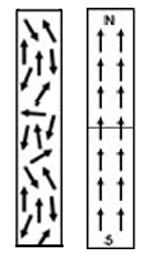
Domain Theory
Ferromagnetic elements like iron, have groups of atoms with their electron spins aligned. These regions are called domains and each domain is like a mini-bar magnet.
When all the domains are allowed to align, the whole object takes on a large-scale magnetic field.

Slide 7
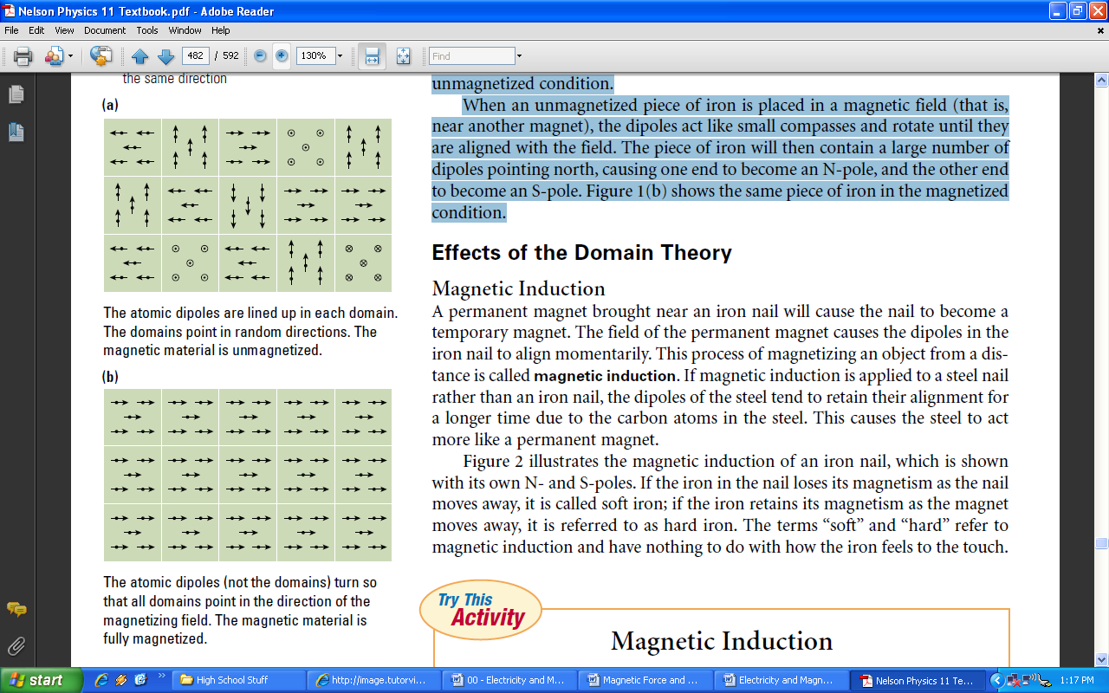
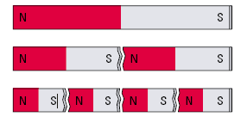
Domain Theory (Continued)

Slide 8
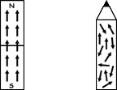
Magnetizing Magnets
Any process that causes the domains to align in a uniform direction will magnetize the material.
  E.g. Stroking the object with a magnet
  E.g. Placing in a uniform electric field

Slide 9
Demagnetizing Magnets
Any process that allows the domains to return to a random state will demagnetize the material.
  E.g. Heating or melting
  E.g. Dropping or Hitting (Shock)
  E.g. Placing in a random electric field

Slide 10
Ferromagnetic Materials
What Materials are Magnetic?
Other Materials cannot be magnetized!

Slide 12
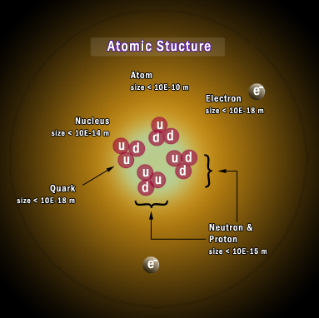
Current in a Magnet?
What causes magnetism in a magnet?
Atoms are the basic building blocks of the Elements. They are neutrally charged, but composed of smaller charged particles:
Quarks - combine to form neutrally charged neutrons and positively charged protons in the nucleus
Electrons – negatively charged particles that orbit the nucleus in variously shaped “shells” or energy levels.
Electrons’ orbital motion as well as quantum mechanical spin produce an electric current and hence a magnetic field in the atom.

Slide 13
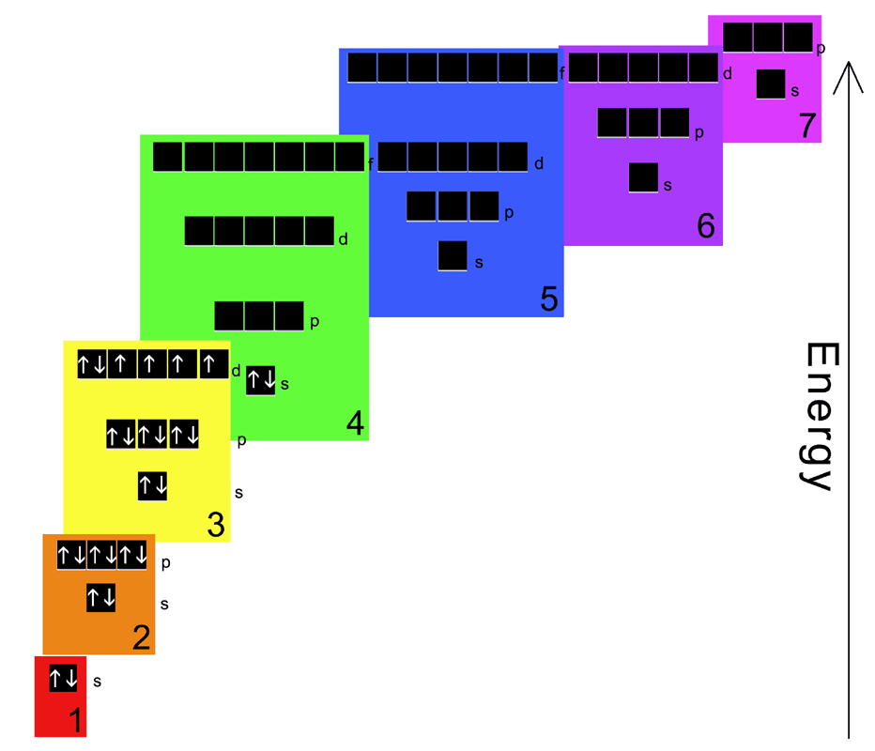
Current in a Magnet?
What causes magnetism in a magnet?
In most atoms, the magnetic fields generated by each electron cancel each other out.
In an atom two electrons can pair up and occupy an energy level, but their spins are opposite of each other, canceling their magnetic field.
But in a few atoms (like Fe, Co, and Ni) there are unpaired electrons in different energy levels whose spins can align and give the atoms an overall magnetic field.
Electron Structure of Iron
4 unpaired electrons

Slide 14
The Law of Magnetism
The law states:
  Like magnetic poles repel
  Unlike magnetic poles attract
In many ways magnetism is similar to electricity
  e.g. Law of Electric Charges
Also, in many ways they are different:
  e.g. Magnetism does not flow in a circuit

